Slide 1


Team 70: VFD Motor Controller
Bi-Weekly Update 5
Mackenzie Miller
Andrew Nguyen
Aidan Rader
Ryan Regan Sponsor: John Lusher TA: Ali Alenezi
Notes:
Mackenzie
30 seconds
Guidance on preparing status update 5 -Theme of this presentation is System Validation. Validation is different than testing and different from verification. Verification is conducted typically as a bench test in the lab during development to check if requirements are met. Tests are usually subsystem or integrated subsystem focused. Validation ensures that the system satisfies requirements, regulations, specifications, and complete cross-conditions of operation for the system. The test planning and execution that we have completed underlies the validation process. System validation is performed on the “full-up” system during or after system integration. System validation is done in real or an accurately simulated environment that system will be operating in. -This update should cover what was accomplished in weeks 9 & 10 and what is planned for weeks 11 and 12 (This period is completion of system test and validation) -Integration should be complete (possibly some reintegration with final PCBs, final ML models, final look/feel for app, etc) Functional system tests, requirements (range) testing, and error testing should be well underway or done. -If you are still doing subsystem bringup and integration, you are putting your project at great risk. You should discuss these scenarios with your TA & prof -This status update should focus on System test and Validation status
Validation -For validation, we need to move from bench test environment to more realistic lab or actual environment that the system would be deployed in. That means you should have scenarios that you have or will test in the field or in accurately simulated environments – same or representative location, terrain, real or accurately emulated users, physical & environmental condition, etc -Fidelity of prototype should be very high – exact hardware and software that the final system will use, PCBs not breadboards, actual external equipment of systems that your system will interact with. Where prototype level hardware and software is used, it should be reported as such. -We STRONGLY suggest using a scenario-based validation process. Scenarios should be developed, owned by one team member, carried out (may be done by 1 person or may require entire team), and results should be recorded. Scenario results should be presented in your demo and documented in your final report. -Scenarios are end to end targeted uses of your system that capture the operations of your system that you specified in your con ops (with specifics for operating modes, users, and sequences of actions). -Scenarios should cover all major normal uses of your system for all modes: eg. System setup/calibration process; use by general user, user by someone with additional responsibility/authority .. Maintainer, auditor, manager,...; maximum demand usage; coverage of operation ranges and environments, etc. Scenarios to show operation to minimum function depending on resource usage or system demand changes. -Scenarios can be developed to show correct operation for one or more requirements that you specified in your FSR. -Scenarios should also include operation outside normal operation – incorrect request/actions by a user; failures and disaster recovery scenarios; recover processes; -May include system lifecycle scenarios – updating a sw/hw component; expanding service or operation; decommissioning the system;

Slide 2
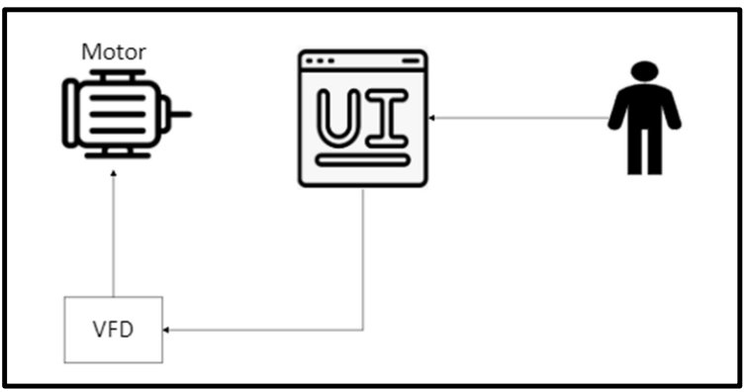
Project Summary
Problem: Traditional motor control systems cannot adjust to varying load demands, resulting in poor energy efficiency, excessive heat generation, and premature component failure
Solution: Develop a Variable Frequency Drive (VFD) motor control system to adjust frequency and voltage to load demands
Notes:
Mackenzie
30 seconds
What is the problem that we are solving
High-level summary of what system does to solve the problem
Picture / Diagram here

Slide 3
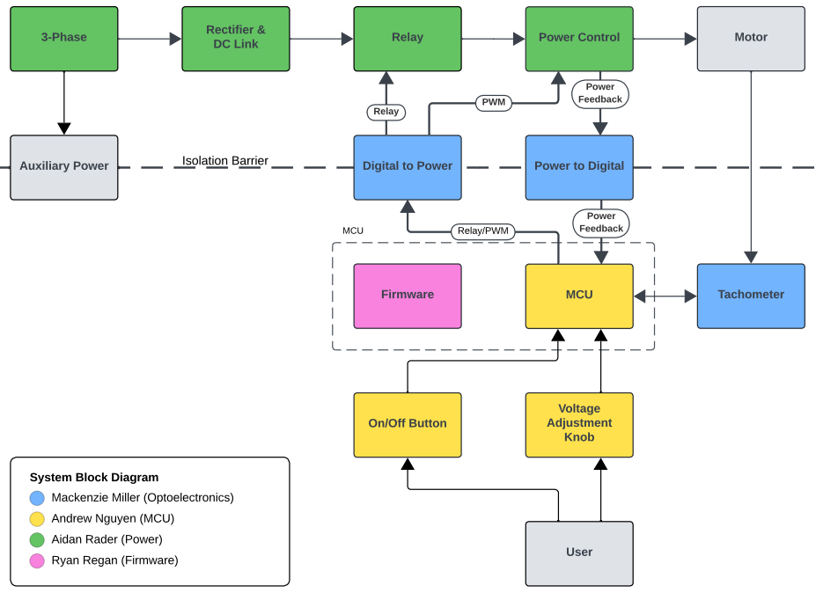
Project/Subsystem Overview
Notes:
Aidan
30 seconds
Diagram showing subsystems – with labels showing subsystem owners

Slide 4
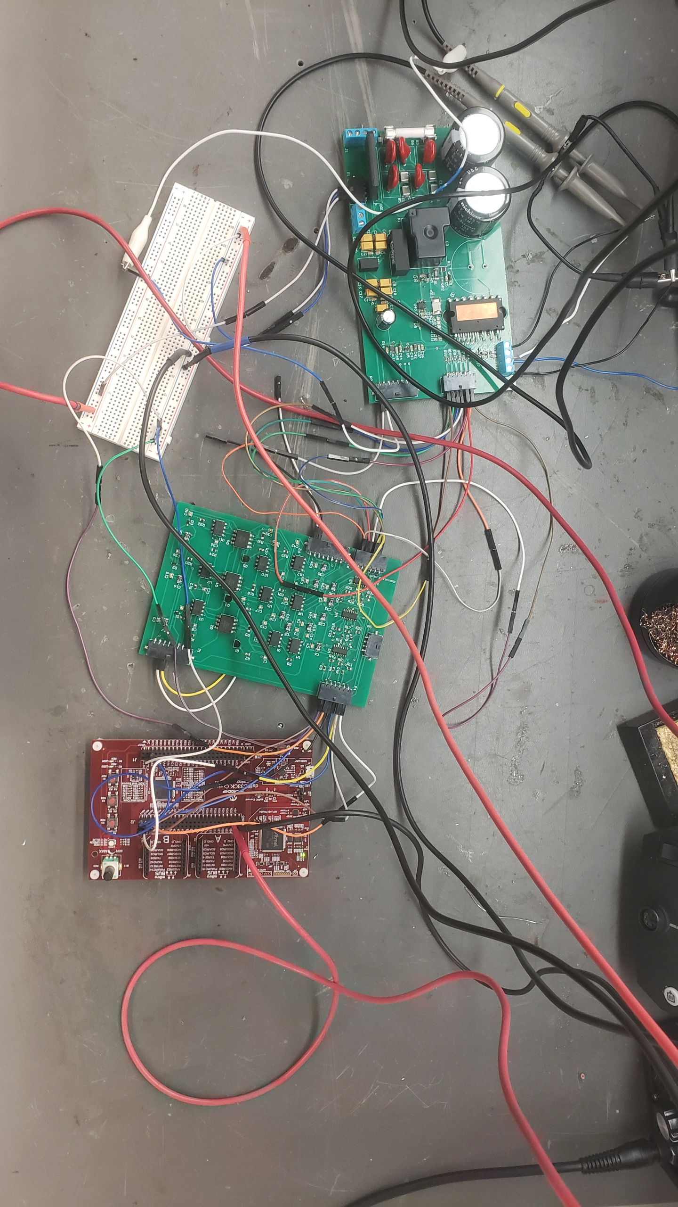
Integrated System Diagram
Notes:
Aidan
90 seconds
This should show the complete system – with picture of packaged solution or conceptual diagram of packaged solution.
Show how it connects to the outside world (communication, interfaces).
If appropriate show internal breakdown and interfaces.
SW projects should show data repository/db; mobile/web app connectivity; front end vs backend; and give representative screens users will see – real look-and-feel
UPDATE This if necessary to show final system
organization, environment, and users!
Unacceptable – not integrated
Good – shows enclosure, integrated
Perfect – Shows packaged amplifier, app for interface, and users headphones

Slide 5
Project Timeline
2/12 | 2/19 | 3/7 | 3/19 | 4/2 | 4/16 | 4/28
Subsystem PCBv1 Design, Assembly, & Testing | Auxiliary Power & MCU/Firmware Integration | PWM Control Integration | System Integration | System Testing | System Validation | Demo, Showcase, & Report
Notes:
Aidan
45 seconds
-Target or actual dates within or above boxes – green done, yellow underway, red in trouble, white not started
-Just quick overview...do not talk about work completed weeks ago, concentrate on past few weeks and upcoming activity. -Save detail for individual team member updates and execution/validation plan

Slide 6
Optoelectronics
Mackenzie Miller
Accomplishments since last update 39 hrs of effort | Ongoing progress/problems and plans until the next presentation
Designed and populated new board Cut traces and blue wire old board Complete auxiliary power Tested power feedback circuit | Test new isolators Fully integrate pwm and relay with new components Complete power feedback integration
Notes:
Mackenzie
30 seconds
For 5th review Accomplishments should include system testing and specific validation scenarios results:
-“Validated correct system operation for temperatures from 25C to 50C”
-“Completed battery lifetime system test for maximum workload and simple workload cases”
-“Validated back end database loss and recovery”
-“Tested image detection in flight Pi-4 on drone with detection accuracy of XX”
-“Validated all app error handling for valve failures”
-“ON-GOING 5 day field test of monitoring system”
-“Developing validation scenarios for mobile user operating through App and dispatcher functions through web app interface

Slide 7
Microcontroller
Andrew Nguyen
Accomplishments since last update 23 hrs of effort | Ongoing progress/problems and plans until the next presentation
Ordered and assembled final board Flashed code onto new board Tested auxiliary power with the power subsytem Ensured potentiometer works properly | Fully integrate with optoelectronics and power subsystems
Notes:
Andrew
30 seconds
For 5th review Accomplishments should include system testing and specific validation scenarios results:
-“Validated correct system operation for temperatures from 25C to 50C”
-“Completed battery lifetime system test for maximum workload and simple workload cases”
-“Validated back end database loss and recovery”
-“Tested image detection in flight Pi-4 on drone with detection accuracy of XX”
-“Validated all app error handling for valve failures”
-“ON-GOING 5 day field test of monitoring system”
-“Developing validation scenarios for mobile user operating through App and dispatcher functions through web app interface

Slide 8
Power
Aidan Rader
Accomplishments since last update 27.5 hrs of effort | Ongoing progress/problems and plans until the next presentation
Tested Rectifier under 120 V_{AC} Integrated Auxiliary Power with Optoelectronics Integrated Blue-wired fried traces Research ribbon cables Routed pcbv2 Updated EGND traces Updated blue-wire traces Adjusted connectors | Integrating PWM Control with Microcontroller Integrating Relay Control with Microcontroller Fried Rectifier Fried Relay or MOSFET Reintegrating with Optoelectronics Integrate Power Feedback Needs PWM Control Integrated System Integration/Tests Update Validation Plan/Tests
Notes:
Aidan
30 seconds
For 5th review Accomplishments should include system testing and specific validation scenarios results:
-“Validated correct system operation for temperatures from 25C to 50C”
-“Completed battery lifetime system test for maximum workload and simple workload cases”
-“Validated back end database loss and recovery”
-“Tested image detection in flight Pi-4 on drone with detection accuracy of XX”
-“Validated all app error handling for valve failures”
-“ON-GOING 5 day field test of monitoring system”
-“Developing validation scenarios for mobile user operating through App and dispatcher functions through web app interface

Slide 9
Firmware
Ryan Regan
Accomplishments since last update 23 hrs of effort | Ongoing progress/problems and plans until the next presentation
Fixed Problem with PWM Frequencies being too slow (print statements slowing the iterations) Helped to find problem with MCU LEDs and Potentiometer Helped desolder parts for optoelectronics Flashed code onto new MCU board – potentiometer works now | Help other subsystems with soldering/desoldering new parts/boards Full system PWM control integration Test with motor Help integrate power feedback
Notes:
Ryan
30 seconds
For 5th review Accomplishments should include system testing and specific validation scenarios results:
-“Validated correct system operation for temperatures from 25C to 50C”
-“Completed battery lifetime system test for maximum workload and simple workload cases”
-“Validated back end database loss and recovery”
-“Tested image detection in flight Pi-4 on drone with detection accuracy of XX”
-“Validated all app error handling for valve failures”
-“ON-GOING 5 day field test of monitoring system”
-“Developing validation scenarios for mobile user operating through App and dispatcher functions through web app interface

Slide 10
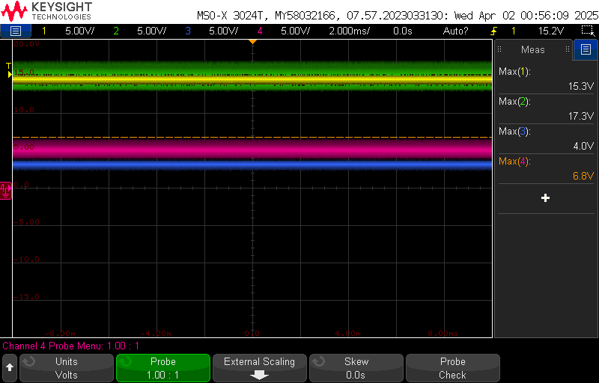
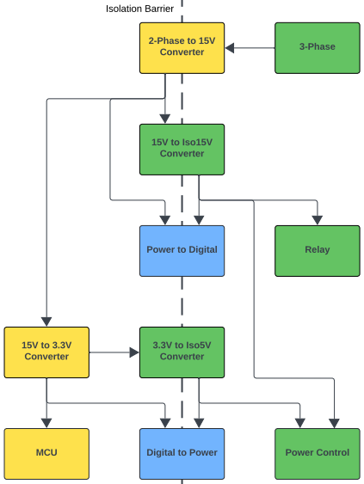
Auxiliary Power Integration Optoelectronics, Microcontroller, & Power Mackenzie Miller, Andrew Nguyen, & Aidan Rader
With Component Loads:
Working with slight voltage differences
Converter | V_{in} [V] | V_{out,measured} [V]
2-Phase to 15V | 120.0 Vac | 15.3
15V to Iso15V | 15.0 | 17.3
15V to 3.3V | 15.0 | 4.0
3.3V to Iso5V | 3.2 | 6.8
Component | V_{in,min} [V] | V_{in,max} [V] | V_{in,measured} [V]
Power to Digital | 0.0 | 30.0
Relay | 11.25 | 16.5
Power to Digital | 0.0 | 30.0
Power Control | 14.5 | 18.5
MCU | 3.0 | 3.6
Digital to Power | 2.5 | 5.5
Digital to Power | 2.5 | 5.5
Power Control
Notes:
-This should all be test and validation results! – show things working, functional test results, error checking, etc, what validation is planned using what scenarios
-Show test and validation results for integrated
systems

Slide 11
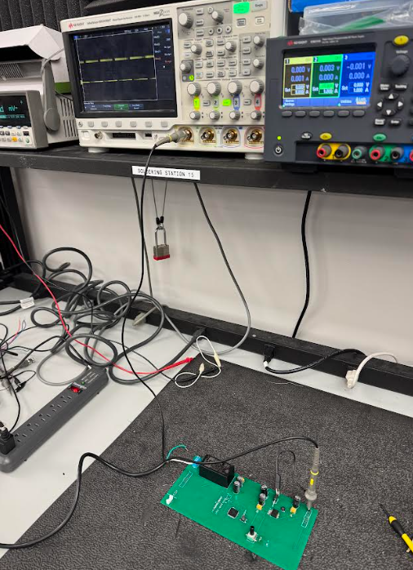
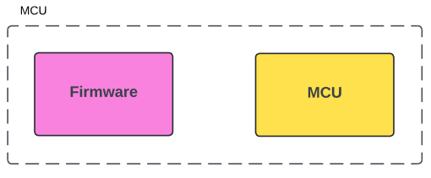
MCU/Firmware Integration Microcontroller & Firmware Andrew Nguyen & Ryan Regan
Complete/successful integration
New MCU Board
Fixed AVDD pin connection to 3.3V
Code flashed onto new board and correctly outputs all PWM waves and the relay signal
Potentiometer works now
Notes:
-This should all be test and validation results! – show things working, functional test results, error checking, etc, what validation is planned using what scenarios
-Show test and validation results for integrated
systems

Slide 12
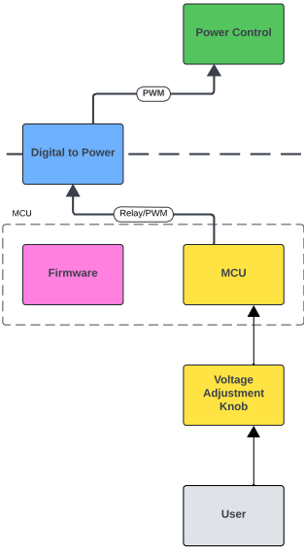
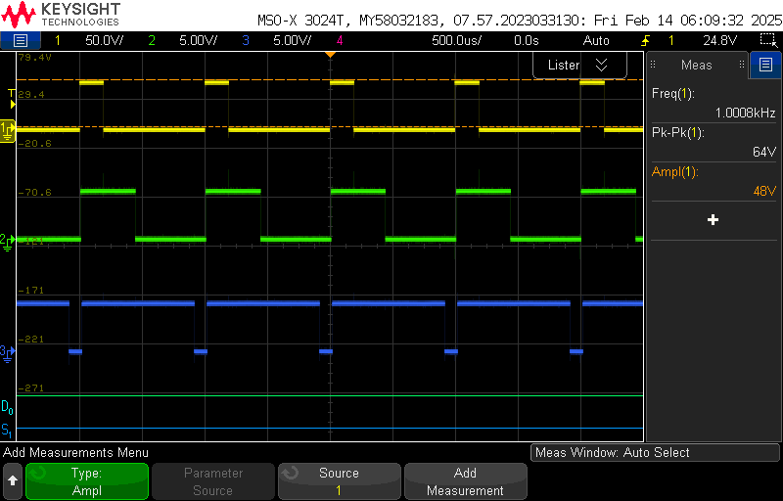
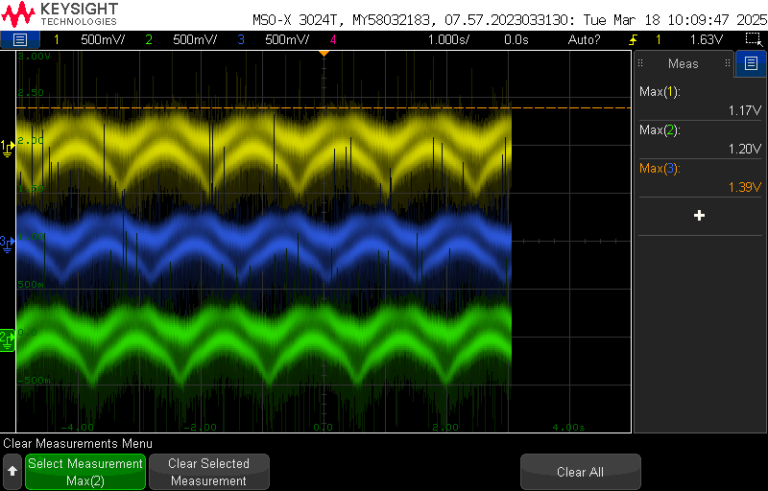
PWM Control Integration
Microcontroller/Firmware-> Optoelectronics -> Power:
3.3V Square Wave: working
5V Square Wave: not working
3-Phase Sine Waves: not working
Firmware (Dev Board) -> Optoelectronics -> Power:
3.3V Square Wave: working
5V Square Wave: previously working
3-Phase Sine Waves: previously working
Optoelectronics:
Previously working, but not currently: fried components
Notes:
Aidan
-This should all be test and validation results! – show things working, functional test results, error checking, etc, what validation is planned using what scenarios
-Show test and validation results for integrated
systems

Slide 13
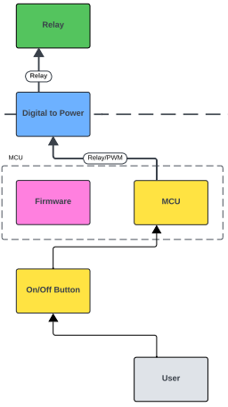










Relay Control Integration
Microcontroller -> Power:
Not working
Firmware (Dev Board) -> Optoelectronics -> Power:
Previously working
Optoelectronics:
Previously working, but not currently: fried components
Power:
Previously working, but not currently: fried components
Notes:
-This should all be test and validation results! – show things working, functional test results, error checking, etc, what validation is planned using what scenarios
-Show test and validation results for integrated
systems

Slide 14
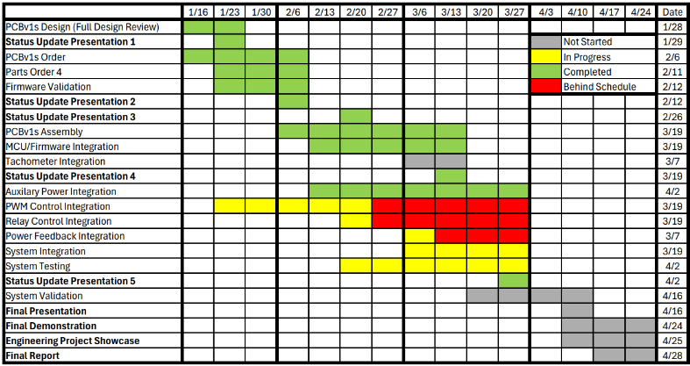
Execution Plan
Notes:
Aidan
45 seconds
Execution plan:
-Your team planned milestones for completion of any remaining integration, functional, range, and error test, and validation plans should be presented.
-Milestones should have owners ... system tests, and full system integration can be group owned
-Engineering milestones only [presentation, demo, document due dates are project milestone that do not belong on this chart]
-Gantt chart.
-DO NOT try to discuss all milestones in the plan – just
high priority present and next engineering milestones

Slide 15
Validation Plan
Paragraph # | Test Name | Success Criteria | Methodology | Status | Responsible Engineer(s)
3.2.1.1 | Speed and Torque Requirement | Motor shall operate within speed range of 0RPM to 1800RPM and torque range of 0lb-ft to 0.729lb-ft. | Input motor with voltage and check if it achieves 0RPM and 0lb-ft . Repeat for 300RPM, 600RPM, 900RPM, 1200RPM, 1500RPM, 1800RPM. | Untested | Andrew, Ryan
3.2.1.2 | Frequency Requirement | System shall operate within frequency range of 5Hz to 60Hz. | Input system with frequency generator set to 5Hz and check if the motor runs smoothly. Repeat for 10Hz, 20Hz, 30Hz, 40Hz, 50Hz, 60Hz. | Untested | All
3.2.1.3 | Temperature Requirement | System shall operate within temperature range of 0˚C to 70˚C. | Place system in freezer set to 0˚C and check if the motor runs smoothly. Repeat with oven set to 70˚C. | Untested | All
3.2.3.2 | Input Voltage Level | System input voltage shall be 208V_{AC}. | Measure with multimeter and check if the voltage is 208V_{AC}. | Untested | Aidan
3.2.3.3 | Input Noise and Ripple | System shall not exceed ripple range of 0V to 0.165V. | Measure with multimeter and check if the voltage exceeds 0V to 0.165V. | Untested | Andrew
3.2.3.4 | External Commands | External commands shall be documented in appropriate ICD. | Show to teaching team and check with them for approval. | Untested | All
3.2.3.5 | Visual Output | Oscilloscope displays each of the three phases of the PWM sine wave. | Connect oscilloscope probes to the set output pins for the PWM signals, ensure that the signals' duty cycles span from 0-100% and are rougly separated by thirds. | Tested | Ryan
3.2.3.6 | Connectors | System shall use terminal blocks for power and signal connections. | Observe power and signal connections and check if they are are terminal blocks. | Untested | Mackenzie, Andrew, Aidan
3.2.3.7 | Overtemperature Shutdown | System shall automatically shut down if sensor exceeds temperature range of 0˚C to 70˚C. | Place sensor in freezer set to -1˚C and check if sensor is triggered. Repeat with oven set to 71˚C. | Untested | Mackenzie
3.2.3.8 | Built in Test | System shall generate and evaluate test signals to assess failure status. | Compare generated values with known values and check if the failure statuses match. Repeat for six additional sets of values. | Untested | All
3.2.3.9 | Optoelectronics Voltage Constraint | The optoelectronics subsystem shall convert the voltage it receives down to a voltage in the range of 15-20 V. | Test at full power where the opto receives ~60 V. Use a multimeter to measure voltage level on other side of opto barrier. | Untested | Mackenzie
3.2.3.10 | Digital to Power Continuity | The digital to power opto-isolators shall have a voltage of 0V across each component when connecting input to output. | Use a multimeter to ensure that the voltage across each digital isolator is zero. | Tested | Mackenzie
Notes:
Aidan
30 seconds
Validation plan
-This is not a gantt chart.
-Validation plan is a table showing:
-Name: descriptive short description of what is being validated,
-Requirement: Identifer to link to requirement # from conops/fsr/icd
-Success Criteria for validation – range/lifetime/performance metric/physical limit...that must be met.
-Methodology – test procedure followed/observations made/simulations completed/.. to satisfy the validation
-Responsible party
-Status – complete/not complete

Slide 16
Validation Plan
Paragraph # | Test Name | Success Criteria | Methodology | Status | Responsible Engineer(s)
3.2.3.11 | Power to Digital Continuity | The power to digital opto-isolators shall have a voltage of 0V across each component when connecting input to output | Use a multimeter to ensure that the voltage across each power isolator is zero. | Tested | Mackenzie
TBD | Inputs | The parameters are within the expected range. | Confirm that all electrical parameters (voltage, current, power) remain within safe and expected ranges under varying conditions. | Untested | All
TBD | Firmware Code Compiles | MPLab firmware successfully compiles without errors or warnings | Attempt to compile code in MPLab and examine output logs to check for errors or warnings | Tested | Ryan
TBD | Controller Performance | Motor spins according to user defined parameters. | Validate that the system operates efficiently and delivers accurate motor control across the expected range of operating conditions. | Untested | All
TBD | MCU Voltage Step Down | MCU converts the voltage it is given to 3.3V. | Measure the voltage of the signals being sent to the MCU and measure that the MCU converts it to 3.3V. | Untested | Mackenzie, Andrew
TBD | Rectifier Full System | System input voltage shall be rectified from 208V_{AC} to 295V_{DC}. | Measure with multimeter and check if the voltage after the rectifier is 295V_{DC}. | Untested | Aidan
TBD | Rectifier Power Subsystem | System input voltage shall be rectified from 5V_{AC} to 7.1 V_{DC}. | Input 5V_{AC} at differing angles of 120˚ on three waveform generators. Measure with multimeter and check if the voltage after the rectifier is 7.1 V_{DC}. | Tested | Aidan
TBD | Isolated 15V Conversion | System shall convert 15V_{DC} to isolated 15V_{DC}. | Input 15V_{DC} on a dc power supply. Measure with multimeter and check if the voltage after the converter is 15V_{DC}. | Tested | Aidan
TBD | Isolated 5V Conversion | System shall convert 3.3V_{DC} to isolated 5V_{DC}. | Input 3.3V_{DC} on a dc power supply. Measure with multimeter and check if the voltage after the converter is 5V_{DC}. | Untested | Aidan
TBD | User Interface | User is able to change the speed of the rotating PWM values by turning the potentiometer. | Change potentiometer position to lowest, highest, and middle notch to observe that the target frequency of the system is close to 60, 10, and 35 respectively, and the rotating PWM values change pace accordingly | Tested | Ryan
TBD | Frequency Testing | Code properly changes the frequency of the PWM signals | Use oscilloscope or a timer to measure the PWM waves to ensure that the program's target frequency is similar to the actual frequency of the PWM signals. | Untested | Ryan
TBD | Debugger Connection | The Microcontroller shall be able to properly communicate with Pickit4 debugger | Connect the Pickit4 Debugger to microcontroller PCB using the 5 pin connector and ensure that MPLAB X IDE can recognize the device. | Untested | Andrew
Notes:
Aidan
30 seconds
Validation plan
-This is not a gantt chart.
-Validation plan is a table showing:
-Name: descriptive short description of what is being validated,
-Requirement: Identifer to link to requirement # from conops/fsr/icd
-Success Criteria for validation – range/lifetime/performance metric/physical limit...that must be met.
-Methodology – test procedure followed/observations made/simulations completed/.. to satisfy the validation
-Responsible party
-Status – complete/not complete

Slide 17
Thank you

